Slide 1
Early Development of the Caenorhabditis elegans

Slide 2
Why C. elegans?
Our ability to analyze development requires appropriate organisms.
Sea urchins have long been a favorite organism of embryologists because their gametes are readily obtainable in large numbers, their eggs and embryos are transparent, and fertilization and development can occur under laboratory conditions.
But sea urchins are difficult to rear in the laboratory for more than one generation, making their genetics difficult to study.

Slide 3
Geneticists, on the other hand (at least those working with multicellular eukaryotes), favor Drosophila.
Its rapid life cycle, its readiness to breed, and the polytene chromosomes of the larva (which allow gene localization) make the fruit fly superbly suited for hereditary analysis.
But Drosophila development is complex and difficult to study.

Slide 4
A research program spearheaded by Sydney Brenner (1974) was set up to identify an organism wherein it might be possible to identify each gene involved in development as well as to trace the lineage of every single cell.
The researchers settled upon Caenorhabditis elegans, a small (1 mm long), free-living soil nematode.
It has a rapid period of embryogenesis (about 16 hours), which it can accomplish in a petridish, and relatively few cell types.
Moreover, its predominant adult form is hermaphroditic, with each individual producing both eggs and sperm.

Slide 5
These roundworms can reproduce either by self-fertilization or by cross-fertilization with the infrequently occurring males.
The body of an adult C. elegans hermaphrodite contains exactly 959 somatic cells, whose entire lineage has been traced through its transparent cuticle.
Furthermore, unlike vertebrate cell lineages, the cell lineage of C. elegans is almost entirely invariant from one individual to the next.
There is little room for randomness.
C. elegans also has a small number of genes for a multicellular organism—about 19,000—and its genome has been entirely sequenced, the first ever for a multicellular organism.

Slide 6
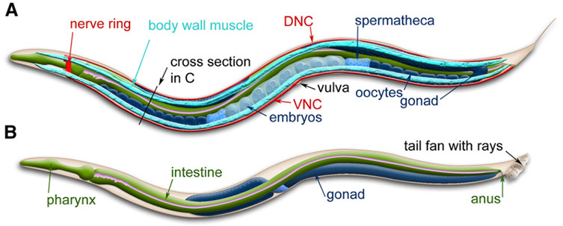

Slide 7
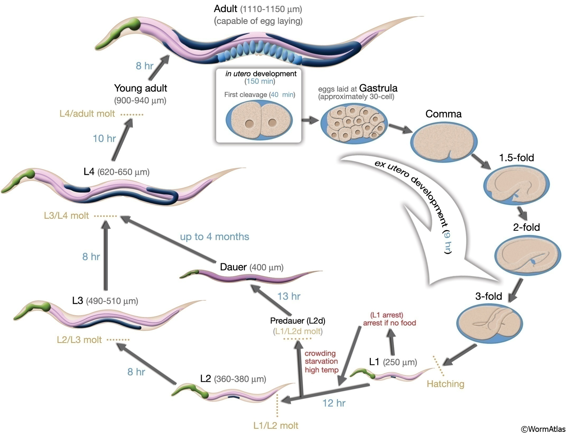

Slide 8
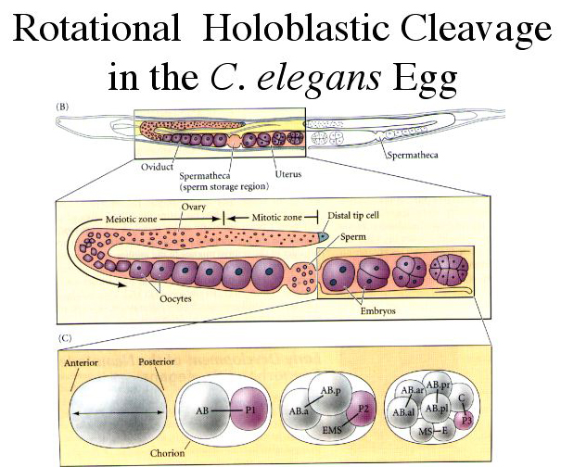

Slide 9
Adult hermaphrodite.
Sperm are stored so that a mature egg must pass through the sperm on its way to the vulva.
(B) The gonads.
Near the distal end, the germ cells undergo mitosis.
As they get further from the distal tip, they enter meiosis.
Early meiosis forms sperm that are stored in the spermatheca.
Later meioses form eggs that become fertilized as they roll through the spermatheca.
(C) Early development, as the egg is fertilized and moves toward the vulva.
The p-lineage are stem cells that will eventually form the germ cells.

Slide 10
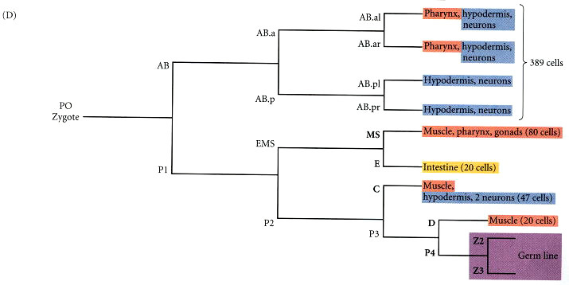
(D) Abbreviated cell lineage chart.
The germ line segregates into the posterior portion of the most posterior (P) cell.
The first three cell divisions produce the AB, C, MS, and E lineages.
The number of derived cells (in parentheses) refers to the 558 cells present in the newly hatched larva.
Some of these continue to divide to produce the 959 somatic cells of the adult.

Slide 11
Cleavage and Axis Formation in C. elegans
Rotational cleavage of the C. elegans egg
During early cleavage, each asymmetrical division produces one founder cell (denoted AB, MS, E, C, and D), which produces differentiated descendants, and one stem cell (the P1-P4 lineage).
In the first cell division, the cleavage furrow is located asymmetrically along the anterior-posterior axis of the egg, closer to what will be the posterior pole. It forms a founder cell (AB) and a stem cell (P1).
During the second division, the anterior founder cell (AB) divides equatorially (longitudinally; 90° to the anterior-posterior axis), while the P1 cell divides meridionally (transversely) to produce another founder cell (EMS) and a posterior stem cell (P2).
The stem cell lineage always undergoes meridional division to produce an anterior founder cell and a posterior cell that will continue the stem cell lineage.

Slide 12
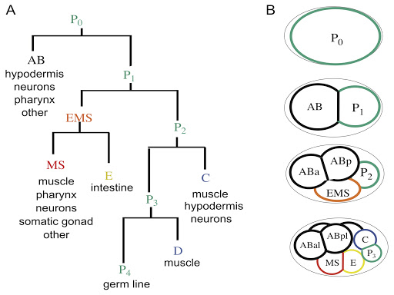

Slide 13
The descendants of each founder cell divide at specific times in ways that are nearly identical from individual to individual.
In this way, the exactly 558 cells of the newly hatched larva are generated.
The descendants of the founder cells can be observed through the transparent cuticle and are named according to their positions relative to their sister cells.
For instance, ABal is the “left-hand” daughter cell of the ABa cell, and ABa is the “anterior” daughter cell of the AB cell.

Slide 14
Anterior-posterior axis formation
The elongated axis of the C. elegans egg defines the future anterior-posterior axis of the nematode's body.
The decision as to which end will become the anterior and which the posterior seems to reside with the position of sperm pronucleus.
When it enters the oocyte cytoplasm, the centriole associated with the sperm pronucleus initiates cytoplasmic movements that push the male pronucleus to the nearest end of the oblong oocyte.
This end becomes the posterior pole.

Slide 15
A second anterior-posterior asymmetry seen shortly after fertilization is the migration of the P-granules.
P-granules are ribonucleoprotein complexes that probably function in specifying the germ cells.
Using fluorescent antibodies to a component of the P-granules, Strome and Wood discovered that shortly after fertilization, the randomly scattered P-granules move toward the posterior end of the zygote, so that they enter only the blastomere (P1) formed from the posterior cytoplasm.
The P-granules of the P1 cell remain in the posterior of the P1 cell and are thereby passed to the P2 cell when P1 divides.
During the division of P2 and P3, however, the P-granules become associated with the nucleus that enters the P3 cytoplasm.

Slide 16
Eventually, the P-granules will reside in the P4 cell, whose progeny become the sperm and eggs of the adult.
The localization of the P-granules requires microfilaments, but can occur in the absence of microtubules.
Treating the zygote with cytochalasin D (a microfilament inhibitor) prevents the segregation of these granules to the posterior of the cell, whereas demecolcine (a colchicine-like microtubule inhibitor) fails to stop this movement.
The partitioning of the P-granules and the orientation of the mitotic spindles are both deficient in those embryos whose mothers were deficient in any of the par (partition-defective) genes.
The proteins encoded by these genes are found in the cortex of the embryo and appear to interact with the actin cytoskeleton.

Slide 17
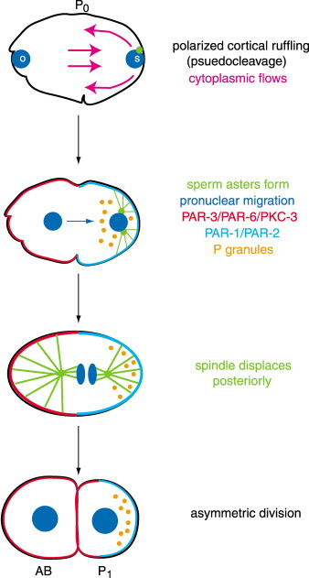

Slide 18
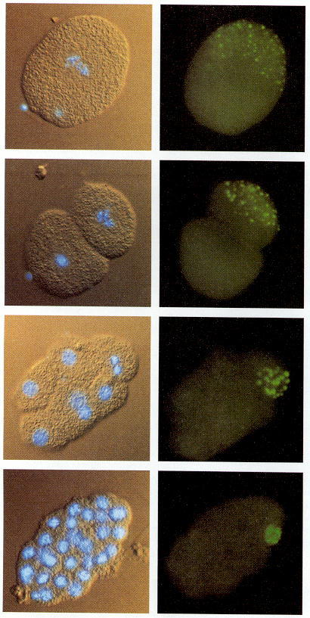
Segregation of the P-granules into the germ line lineage of the C. elegans embryo.
The left column shows the cell nuclei (the DNA is stained blue by Hoescht dye), while the right column shows the same embryos stained for P-granules.
At each successive division, the P-granules enter into the P-lineage blastomere, the one that will form the germ cells.

Slide 19
Formation of the dorsal-ventral and right-left axes
The dorsal-ventral axis of the nematode is seen in the division of the AB cell.
As the AB cell divides, it becomes longer than the eggshell is wide.
This causes the cells to slide, resulting in one AB daughter cell being anterior and one being posterior (hence their names, ABa and ABp, respectively).
This squeezing also causes the ABp cell to take a position above the EMS cell that results from the division of the P1 blastomere.

Slide 20
The ABp cell defines the future dorsal side of the embryo, while the EMS cell, the precursor of the muscle and gut cells, marks to future ventral surface of the embryo.
The left-right axis is specified later, at the 12-cell stage, when the MS blastomere (from the division of the EMS cell) contacts half the “grand-daughters” of the ABa cell, distinguishing the right side of the body from the left side.

Slide 21
Control of blastomere identity
C. elegans demonstrates both the conditional and autonomous modes of cell specification.
Both modes can be seen if the first two blastomeres are experimentally separated.
The P1 cell develops autonomously without the presence of AB.
It makes all the cells that it would normally make, and the result is the posterior half of an embryo.
However, the AB cell, in isolation, makes only a fraction of the cell types that it would normally make.
For instance, the resulting ABa blastomere fails to make the anterior pharyngeal muscles that it would have made in an intact embryo.
Therefore, the specification of the AB blastomere is conditional, and it needs the descendants of the P1 cell to interact with it.

Slide 22
Autonomous specification
The determination of the P1 lineages appears to be autonomous, with the cell fates determined by internal cytoplasmic factors rather than by interactions with neighboring cells.
It is thought that protein factors might determine cell fate by entering the nuclei of the appropriate blastomeres and activating or repressing specific fate-determining genes.
The SKN-1, PAL-1, and PIE-1 proteins are thought to encode transcription factors that act intrinsically to determine the fates of cells derived from the four P1-derived somatic founder cells, MS, E, C, and D.

Slide 23
The SKN-1 protein is a maternally expressed polypeptide that may control the fate of the EMS blastomere, the cell that generates the posterior pharynx.
After first cleavage, only the posterior blastomere, P1, has the ability to autonomously produce pharyngeal cells when isolated.
After P1 divides, only EMS is able to generate pharyngeal muscle cells in isolation.
Similarly, when the EMS cell divides, only one of its progeny, MS, has the intrinsic ability to generate pharyngeal tissue.
These findings suggest that pharyngeal cell fate may be determined autonomously by maternal factors residing in the cytoplasm that are parceled out to these particular cells.

Slide 24
Bowerman and his co-workers found maternal effect mutants lacking pharyngeal cells, and isolated a mutation in the skn-1 gene.
Embryos from homozygous skn-1-deficient mothers lack both pharyngeal mesoderm and endoderm derivatives of EMS.
Instead of making the normal intestinal and pharyngeal structures, these embryos seem to make extra hypodermal (skin) and body wall tissue where their intestine and pharynx should be.
In other words, EMS appears to be respecified as C. Only those cells that are destined to form pharynx or intestine are affected by this mutation.

Slide 25
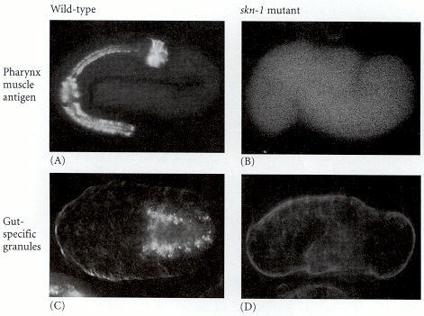
Deficiencies of intestine and pharynx in skn-1 mutants of C. elegans.

Slide 26
A second possible transcription factor, PAL-1, is also required for the differentiation of the P1 lineage.
PAL-1 activity is needed for the normal development of the somatic descendants of the P2 blastomere.
Thus, embryos lacking PAL-1 have no somatic cell types derived from the C and D stem cells.
PAL-1 is regulated by the MEX-3 protein, an RNA-binding protein that appears to inhibit the translation of the pal-1 mRNA.
Wherever MEX-3 is expressed, PAL-1 is absent.

Slide 27
Thus, in mex-3-deficient mutants, PAL-1 is seen in every blastomere. SKN-1 also inhibits PAL-1 (thereby preventing it from becoming active in the EMS cell).
A third putative transcription factor, PIE-1, is necessary for germ line fate.
PIE-1 appears to inhibit both SKN-1 and PAL-1 function in the P2 and subsequent germ line cells.
Mutations of the maternal pie-1 gene result in germ line blastomeres adopting somatic fates, with the P2 cell behaving similarly to a wild-type EMS blastomere.
The localization and the genetic properties of PIE-1 suggest that it represses the establishment of somatic cell fate and preserves the totipotency of the germ cell lineage.

Slide 28
Conditional specification
The C. elegans embryo uses both autonomous and conditional modes of specification.
Conditional specification can be seen in the development of the endoderm cell lineage.
At the 4-cell stage, the EMS cell requires a signal from its neighbor (and sister), the P2 blastomere.
Usually, the EMS cell divides into an MS cell (which produces mesodermal muscles) and an E cell (which produces the intestinal endoderm).
If the P2 cell is removed at the early 4-cell stage, the EMS cell will divide into two MS cells, and endoderm will not be produced.
If the EMS cell is recombined with the P2 blastomere, however, it will form endoderm; it will not do so, however, when combined with ABa, ABp, or both AB derivatives.

Slide 29
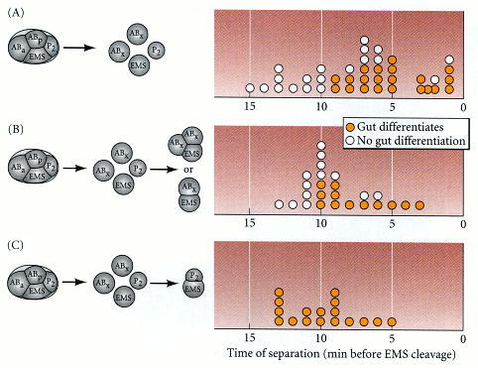
Results of isolation and recombination experiments, showing that cellular interactions are required for the EMS cell to form intestinal lineage determinants.
(A) When isolated shortly after its formation, the EMS blastomere cannot produce gut-specific granules. If left in place for longer periods, it can.
(B) If the EMS cell is recombined with either or both derivatives of the AB blastomere, it will not form gut-specific granules.
(C) If recombined with the P2 blastomere, the EMS cell will give rise to gut-specific structures.

Slide 30
The P2 cell produces a signal that interacts with the EMS cell and instructs the EMS daughter that is next to it to become the E cell.
This message is transmitted through the Wnt signaling cascade.
The P2 cell produces the C. elegans homologue of a Wnt protein, the MOM-2 peptide.
The MOM-2 peptide is received in the EMS cell by the MOM-5 protein, the C. elegans version of the Wnt receptor protein, Frizzled.
The result of this signaling cascade is to down-regulate the expression of the pop-1 gene in the EMS daughter destined to become the E cell.
In pop-1-deficient embryos, both EMS daughter cells become E cells.

Slide 31
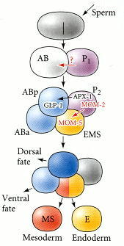
Cell-cell signaling in the 4-cell embryo of C. elegans.
The P2 cell produces two signals

Slide 32
The P2 cell is also critical in giving the signal that distinguishes ABp from its sister cell, ABa.
ABa gives rise to neurons, hypodermis, and the anterior pharynx cells, while ABp makes only neurons and hypodermal cells.
However, if one experimentally reverses their positions, their fates are similarly reversed, and a normal embryo is formed.
In other words, ABa and ABp are equivalent cells whose fate is determined by their positions within the embryo.

Slide 33
Transplantation and genetic studies have shown that ABp becomes different from ABa through its interaction with the P2 cell.
In an unperturbed embryo, both ABa and ABp contact the EMS blastomere, but only ABp contacts the P2 cell.
If the P2 cell is killed at the early 4-cell stage, the ABp cell does not generate its normal complement of cells.
Contact between ABp and P2 is essential for the specification of ABp cell fates, and the ABa cell can be made into an ABp-type cell if it is forced into contact with P2.

Slide 34
These studies show that this interaction is mediated by the GLP-1 protein on the ABp cell and the APX-1 (anterior pharynx excess) protein on the P2 blastomere.
In embryos whose mothers have mutant glp-1, ABp is transformed into an ABa cell.
The GLP-1 protein is a member of a widely conserved family called the Notch proteins, which serve as cell membrane receptors in many cell-cell interactions, and it is seen on both the ABa and ABp cells.

Slide 35
One of the most important ligands for Notch proteins such as GLP-1 is another cell surface protein called Delta.
In C. elegans, the Delta-like protein is APX-1, and it is found on the P2 cell.
This APX-1 signal breaks the symmetry between ABa and ABp, since it stimulates the GLP-1 protein solely on the AB descendant that it touches, namely, the ABp blastomere.
In doing this, the P2 cell initiates the dorsal-ventral axis of C. elegans, and it confers on the ABp blastomere a fate different from that of its sister cell.

Slide 36
Gastrulation in C. elegans
Gastrulation in C. elegans starts extremely early, just after the generation of the P4 cell in the 24-cell embryo.
At this time, the two daughters of the E cell (Ea and Ep) migrate from the ventral side into the center of the embryo.
There, they will divide to form a gut consisting of 20 cells.
There is a very small and transient blastocoel prior to the movement of the Ea and Ep cells, and their inward migration creates a tiny blastopore.
The next cell to migrate through this blastopore is the P4 cell, the precursor of the germ cells.
It migrates to a position beneath the gut primordium.

Slide 37
The mesodermal cells move in next: the descendants of the MS cell migrate inward from the anterior side of the blastopore, and the C- and D-derived muscle precursors enter from the posterior side.
These cells flank the gut tube on the left and right sides.
Finally, about 6 hours after fertilization, the AB-derived cells that contribute to the pharynx are brought inside, while the hypoblast (hypodermal precursor) cells move ventrally by epiboly, eventually closing the blastopore.

Slide 38
During the next 6 hours, the cells move and organize into organs, and the ball-shaped embryo stretches out to become a worm.
This hermaphroditic worm will have 558 somatic cells.
An additional 115 cells will have formed, but undergone apoptosis.
After four molts, this worm will be a sexually mature adult, containing 959 somatic cells, as well as numerous sperm and eggs.

Slide 39
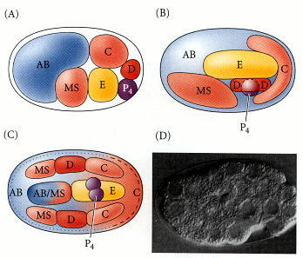
Gastrulation in C. elegans.
(A) Positions of founder cells and their descendants at the 26-cell stage, just prior to gastrulation.
(B) 102-cell stage, after the migration of the E, P4, and D descendants.
(C) Positions of the cells near the end of gastrulation. The dotted and dashed lines represent regions of the hypodermis contributed by AB and C, respectively.
(D) Early gastrulation, as the two E cells start moving inward.

Slide 40
